Slide 1

JAVA Training - Web
Thomas DECOSTER
Java Senior Consultant
VPTT 2020 4.4.7.4 RC /
1

Slide 2

Agenda
HTTP
Servlet
Web.xml + war
Tomcat
Java config
Spring boot

Slide 3
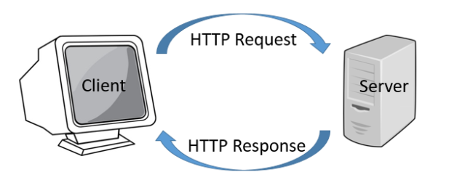
HTTP

Slide 4
HTTP Request Verbs
- Basic verbs :
GET
POST
- More verbs for REST:
PUT
DELETE
PATCH
Other verbs:
HEAD
CONNECT
OPTIONS
TRACE

Slide 5
HTTP Response code
200 OK
4XX Client error
400 bad request
401 Unauthorized
403 Forbidden
404 Not Found
5XX Server error
500 Internal Server Error
503 Service Unavailable

Slide 6
HTTP Headers
User-Agent: Mozilla/5.0
Accept: text/html
Pragma: no-cache
Cache-Control: no-cache
Cookie: user=Bob; age=28; csrftoken=u12t4o8tb9ee73

Slide 7
Servlet
public class HelloWorldServlet extends HttpServlet { protected void doGet(HttpServletRequest request, HttpServletResponse response) throws IOException { response.setContentType("text/html"); PrintWriter out = response.getWriter(); out.println("<h1>Hello World using HttpServlet - GET class.</h1>"); out.close(); } protected void doPost(HttpServletRequest req, HttpServletResponse response) throws IOException { response.setContentType("text/html"); PrintWriter out = response.getWriter(); out.println("<h1>Hello World using HttpServlet - POST class.</h1>"); out.close(); } }

Slide 8
Web.xml
<?xml version="1.0" encoding="UTF-8"?> <web-app id="WebApp_ID" version="2.4" xmlns="http://java.sun.com/xml/ns/j2ee" xmlns:xsi="http://www.w3.org/2001/XMLSchema-instance" xsi:schemaLocation="http://java.sun.com/xml/ns/j2ee http://java.sun.com/xml/ns/j2ee/web-app_2_4.xsd"> <servlet> <servlet-name>HelloWorld</servlet-name> <servlet-class>com.valtech.talent.program.web.servlet.HelloWorldServlet</servlet-class> </servlet> <servlet-mapping> <servlet-name>HelloWorld</servlet-name> <url-pattern>/HelloWorld</url-pattern> </servlet-mapping> <filter> <filter-name>TestFilter</filter-name> <filter-class>com.valtech.talent.program.web.filter.TestFilter</filter-class> </filter> <filter-mapping> <filter-name>TestFilter</filter-name> <url-pattern>/*</url-pattern> </filter-mapping> <welcome-file-list> <welcome-file>login.html</welcome-file> </welcome-file-list> </web-app>

Slide 9
Servlet Filter
public class TestFilter implements Filter { public void doFilter(ServletRequest request, ServletResponse response, FilterChain chain) throws IOException, ServletException { System.out.println("filter do something before"); chain.doFilter(request, response); System.out.println("filter do something after"); } }

Slide 10
Request
String parameter = request.getParameter("PARAM_NAME"); Object attribute = request.getAttribute("ATTR_NAME"); String header = request.getHeader("HEADER_NAME"); Cookie[] cookies = request.getCookies(); ServletInputStream inputStream = request.getInputStream(); HttpSession session = request.getSession();
http headers
Content
Authorization
Cache
Cookies
Session

Slide 11
Response
response.sendError(ERROR_CODE); response.setContentType(CONTENT_TYPE); response.sendRedirect(REDIRECT_URL); Cookie cookie = new Cookie("name" , "value"); response.addCookie(cookie); response.addHeader(HEADER_NAME, HEADER_VALUE); ServletOutputStream outputStream = response.getOutputStream();

Slide 12
Session
Object attr = session.getAttribute("ATTR_NAME"); session.setAttribute("ATTR_NAME", "ATTR_VALUE"); Enumaeration<String> attributeNames = session.getAttributeNames();

Slide 13
Jsp (is another Servlet)

Slide 14
JSF
<?xml version="1.0" encoding="UTF-8"?> <!DOCTYPE html PUBLIC "-//W3C//DTD XHTML 1.0 Transitional//EN" "http://www.w3.org/TR/xhtml1/DTD/xhtml1-transitional.dtd"> <html xmlns="http://www.w3.org/1999/xhtml" xmlns:h="http://xmlns.jcp.org/jsf/html" xmlns:ui="http://xmlns.jcp.org/jsf/facelets" xmlns:f="http://xmlns.jcp.org/jsf/core"> <f:view> <h:outputLabel value="Hello, world"/> <h:dataTable value="#{order.orderList}" var="o" styleClass="order-table" headerClass="order-table-header" rowClasses="order-table-odd-row,order-table-even-row" > <h:column> <f:facet name="header">Order No</f:facet> #{o.orderNo} </h:column> <h:column> <f:facet name="header">Product Name</f:facet> #{o.productName} </h:column> </h:dataTable> </f:view> </html>

Slide 15
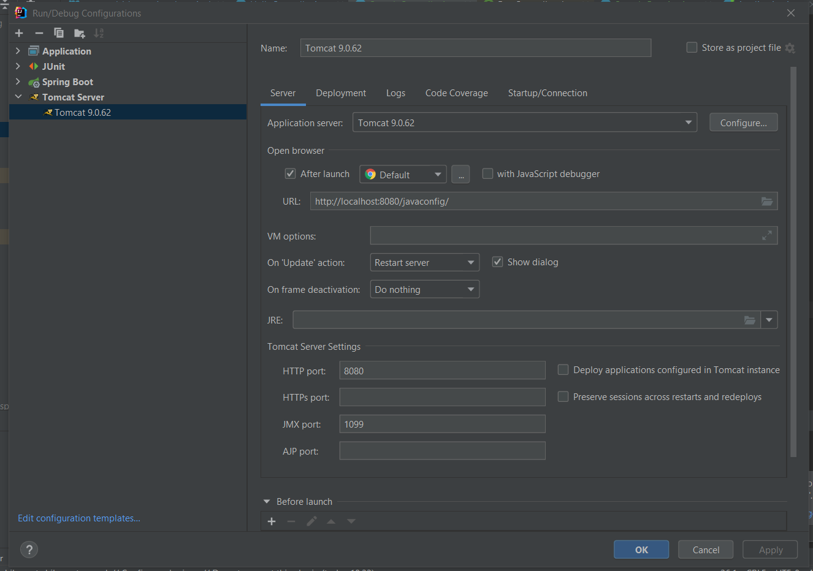
Tomcat
https://tomcat.apache.org/download-90.cgi

Slide 16
Servlet with Java Config (1)
@Slf4j @WebServlet("/javaconfig") public class AppServlet extends HttpServlet { private static final String ATTRIBUTE_STORED_IN_SESSION = "ATTRIBUTE_STORED_IN_SESSION"; public void doGet(HttpServletRequest request, HttpServletResponse response) throws IOException { String msg = handleSession(request); log.info("send servlet response"+ msg); response.getWriter().println("Hello World !" + msg); } private String handleSession(HttpServletRequest request) { HttpSession session = request.getSession(); String attribute = Optional.ofNullable((String) session.getAttribute(ATTRIBUTE_STORED_IN_SESSION)) .map(attr -> attr+"A").orElse("B"); session.setAttribute(ATTRIBUTE_STORED_IN_SESSION, attribute); return attribute; } }

Slide 17
Java Config (2)
@Slf4j @WebFilter("/*") public class AppFilter implements Filter { @Override public void doFilter(ServletRequest servletRequest, ServletResponse servletResponse, FilterChain filterChain) throws IOException, ServletException { log.info("Do something before..."); filterChain.doFilter(servletRequest,servletResponse); log.info("Do something after..."); } }
@Slf4j @WebListener public class WebApplication implements ServletContextListener { @Override public void contextInitialized(ServletContextEvent event) { log.info("The application started"); } @Override public void contextDestroyed(ServletContextEvent event) { log.info("The application stopped"); } }

Slide 18
Spring boot
@SpringBootApplication @ComponentScan("com.valtech.talent.program.web.controller") public class Application { public static void main(String[] args) { SpringApplication.run(Application.class, args); } }

Slide 19
@Controller
@Slf4j @RestController public class HelloController { @PostConstruct public void init(){ log.info("PostConstruct init"); } @GetMapping("greet") public String greet() { log.info("HelloController : greet "); return "Greetings Valtech !"; } @GetMapping public String defaultAnswer() { log.info("HelloController : defaultAnswer "); return "Default : Hello Valtech !"; } }

Slide 20
content-type: multipart/form-data
Multipart
Header: content-type: multipart/form-data
Form:
<form enctype="multipart/form-data" method="post" name="fileinfo">
<input type="file" name="file" required />
...
</form>
@RequestMapping(path = "/sample", method = POST, consumes = { MediaType.MULTIPART_FORM_DATA_VALUE }) public ResponseEntity<Object> saveEmployee(@RequestParam String name, @RequestPart MultipartFile document) { SampleGreeting sample = new SampleGreeting(name, document.getOriginalFilename()); return ResponseEntity.ok().build(); }

Slide 21
Error Handling
@GetMapping("{id}") public SampleGreeting read(@PathVariable String id) { if(id == null || id.trim().equals("")) { throw new ResponseStatusException(HttpStatus.NOT_FOUND, "id parameter is empty"); } return new SampleGreeting("Hello", id); }
// OR
@ControllerAdvice public class ErrorHandlerAdvice extends ResponseEntityExceptionHandler { @ExceptionHandler(value= { IllegalArgumentException.class, IllegalStateException.class }) protected ResponseEntity<Object> handleConflict( RuntimeException ex, WebRequest request) { String bodyOfResponse = "Error while performing action"; return handleExceptionInternal(ex, bodyOfResponse, new HttpHeaders(), HttpStatus.CONFLICT, request); } }

